Slide 1

UNITED NATIONS GLOBAL GEODETIC
CENTRE OF EXCELLENCE
MODERNISING GEOSPATIAL REFERENCE SYSTEM
CAPACITY DEVELOPMENT WORKSHOP
Introduction of data standardisation and data sharing policies
Liubov Poshyvailo-Strube
Associate Geospatial Information Officer, UN-GGCE
Day 2, Session 1 [2_3_1]
HOW

Slide 2


Overview
Introduction
ISO standards
OGC standards
Other standardisation practices
Summary and conclusions
The image is created by Liubov Poshyvailo-Strube with Microsoft Designer, https://designer.microsoft.com/

Slide 3

What would our daily lives look like without standards?
Creative! BUT
In the world without standards,
Could you use your bank card anywhere across the globe?
Would you be able to watch your favourite TV-show in the same format on different devices?
Could you trust quality and safety of the food you eat daily?
The questions are adopted from https://www.iso.org/sites/ConsumersStandards/1_standards.html, accessed 9 January 2025.
The image is created by Liubov Poshyvailo-Strube with Microsoft Designer, https://designer.microsoft.com/
STRONGER.
TOGETHER.

Slide 4
Key definitions: Standard, standardisation
From ISO¹/IEC² Guide 2:2004 “Standardization and related activities – General vocabulary”, https://www.iso.org/standard/39976.html
Standard is a “document, established by consensus and approved by a recognised body, that provides, for common and repeated use, rules, guidelines or characteristics for activities or their results, aimed at the achievement of the optimum degree of order in a given context”, as well as promoting optimal community benefits.
Standardisation is an activity of formulating, issuing, and implementing standards.
STRONGER.
TOGETHER.
ISO – International Organization for Standardization, https://www.iso.org/home.html
IEC – International Electrotechnical Commission, https://www.iec.ch/homepage, https://www.electropedia.org/

Slide 5
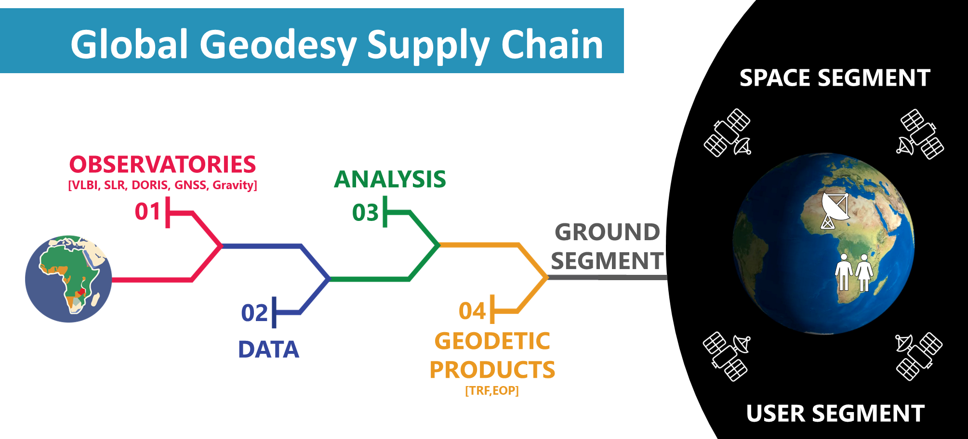
Why do we need standards in geodesy?
Consistency of raw observations from various ground and space-based stations
Consistency of analysed data and geodetic products
Observations and data quality assurance
Interoperability of different geodetic techniques
Compatibility of geodetic data with another geospatial information systems
Seamless access to geodetic products for users
STRONGER.
TOGETHER.

Slide 6
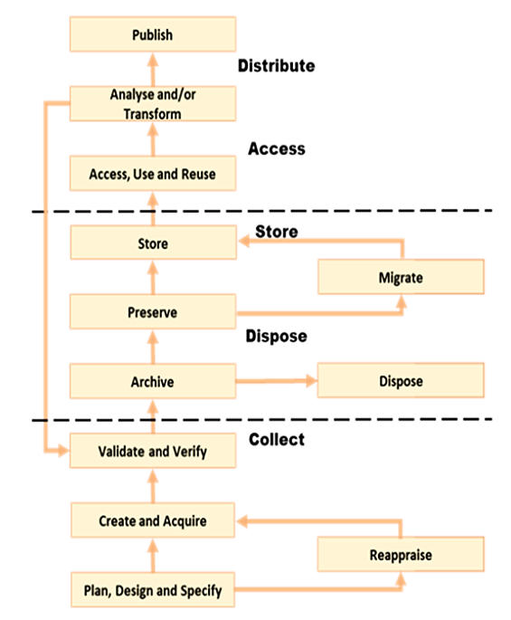
Our focus: Standardisation throughout a geodetic data lifecycle¹
Focus of 2.3 presentations
COLLECT: data specifications and definitions, data and services metadata, data acquisition, data quality, data interchange and formats, etc.
DISPOSE: digital data preservation, data modification, data referencing, data encoding, etc.
STORE: data preservation, data archiving, etc.
ACCESS: data encoding, data processing, data analytics methods, data referencing, grid systems, technology standards, etc.
DISTRIBUTION: data cataloguing, sharing data and metadata, geodetic registers, data naming conventions, data product specification, technology standards, data visualisation, etc.
Lifecycle is a “sequence of events that mark the development and use of a resource”. Source: International Organization for Standardization. ”ISO 5127:2017(en) Information and Documentation – Foundation and Vocabulary”. 2nd ed., https://www.iso.org/obp/ui/en/#iso:std:iso:5127:ed-2:v1:en. Accessed 20 January 2025.
The data lifecycle schematic is adopted from: United Nations Committee of Experts on Global Geospatial Information Management. “Guide to the Role of Standards in Geospatial Information Management”. United Nations, https://standards.unggim.ogc.org/unggim_guide.pdf. Accessed 17 January 2025.

Slide 7







Standards for geospatial information
International Organization for Standardization (ISO), https://www.iso.org
Open Geospatial Consortium (OGC), https://www.ogc.org
International Hydrographic Organization (IHO), https://iho.int
World Wide Web Consortium (W3C), https://www.w3.org
Internet Engineering Task Force (IETF), https://www.ietf.org
American Society for Photogrammetry and Remote Sensing (ASPRS), https://www.asprs.org
Geoscience and Remote Sensing Society (GRSS) of the Institute of Electrical and Electronic Engineers (IEEE), https://www.grss-ieee.org
. . .
STRONGER.
TOGETHER.
Source: United Nations Committee of Experts on Global Geospatial Information Management. “Guide to the Role of Standards in Geospatial Information Management”. United Nations, https://standards.unggim.ogc.org/unggim_guide.pdf. Accessed 17 January 2025.

Slide 8
International bodies that decide on relevant standards for geodesy
BIPM, Bureau International de Poids et Mesures¹
(International Bureau of Weights and Measures)
CODATA, Committee on Data for Science and Technology²
UN-GGIM, United Nations Committee of Experts on Global Geospatial Information Management³
IUGG, International Union of Geodesy and Geophysics⁴
IAU, International Astronomical Union⁵
    Commission A3 “Fundamental Standards”⁵
    The IAU’s Standards of Fundamental Astronomy (SOFA)⁶
IAG, International Association of Geodesy⁷
    Bureau of Products and Standards (BPS)⁹ of the Global Geodetic Observing System (GGOS)⁸
. . .
STRONGER.
TOGETHER.
BIPM, https://www.bipm.org/en/
CODATA, https://codata.org/
UN-GGIM, https://ggim.un.org/
IUGG, https://iugg.org/
IAU, https://www.iau.org/
IAU SOFA, http://iausofa.org/
IAG, https://www.iag-aig.org/
GGOS, https://ggos.org/

Slide 9
OUTLINE
Introduction and key definitions
ISO standards
OGC standards
Other standardisation practices
Summary and conclusions
2.1 What is ISO?
2.2 Geographic locations and coordinates (ISO 6709, ISO 19111, ISO 19161)
2.4 Metadata (ISO 19115)
2.5 Data registry (ISO 19127, ISO 19135)

Slide 10
What is ISO?
International Organization for Standardization (ISO) is an independent, non-governmental international organization founded in 1947, which now links 169 national standards bodies (as of 2023)¹
ISO standards are internationally recognised guidelines and specifications developed by ISO. They are “the formula that describes the best way of doing something”¹
ISO Technical Committee 211 (ISO/TC 211)²
  Develops standards for geographic information and geomatics
  Specifies methods, tools, and services for data management, including acquisition, processing, analysis, access, publishing and transferring of data between different users and systems
  Links to appropriate standards for information technology and data
  Provides a framework for the development of sector-specific applications using geographic data
  Under the direct responsibility of ISO/TC 211³ ⁴
    100 standards published⁵
    28 are under development⁵
International Organization for Standardization. "ISO - International Organization for Standardization." ISO, https://www.iso.org/home.html. Accessed 9 January 2025.
ISO/TC 211. "ISO/TC 211 Geographic information/Geomatics" ISO, https://committee.iso.org/home/tc211. Accessed 9 January 2025.
ISO/TC 211. "ISO/TC 211 Geographic Information/Geomatics. Projects" ISO, https://committee.iso.org/sites/tc211/home/projects.html. Accessed 21 January 2025.
International Organization for Standardization. "ISO/TC 211 Geographic Information/Geomatics." ISO, https://www.iso.org/committee/54904.html. Accessed 21 January 2025.
International Organization for Standardization. “Standards by ISO/TC 211 Geographic information/Geomatics. Catalogue." ISO, https://www.iso.org/committee/54904/x/catalogue/p/1/u/0/w/0/d/0. Accessed 21 January 2025.
STRONGER.
TOGETHER.

Slide 11
ISO 6709 for representing geographic locations
ISO 6709:2022 “Standard representation of geographic point location by coordinates”, https://www.iso.org/standard/75147.html
This document provides a standard for representing geographic locations in numbers, i.e., coordinates, by latitude, longitude, height or depth, and a coordinate reference system. It also specifies machine-readable coordinate formats, suitable for electronic data exchange, and provides guidelines for human-readable coordinate formats.
Coordinates | Conventional NOT ISO 6709:2022 | ISO 6709:2022
 |  | Human-readable | Machine-readable
Latitude | deg [units] | deg, min, sec [units] | ±DD.D [format], deg [units] | ±DDMMSS.S [format], deg, min, sec [units]
 | 40.20361 N | 40°12'13.1“N | +40.20361 | +401213.1
 | N for Northern Hemisphere | N for Northern Hemisphere | “+” for Northern Hemisphere and the equator
 | S for Southern Hemisphere | S for Southern Hemisphere | “-” for Southern Hemisphere
Longitude | deg [units] | deg, min, sec [units] | ±DDD.D [format], deg [units] | ±DDDMMSS.S [format], deg, min, sec [units]
 | 75.00417 W | 075°00'15.1"W | -075.00417 | -0750015.1
 | E indicates east of the Prime Meridian | E indicates east of the Prime Meridian | “+” indicates east of the Prime Meridian and the Prime Meridian
 | W indicates west of the Prime Meridian | W indicates west of the Prime Meridian | “-” indicates west of the Prime Meridian and 180° meridian (opposite to the Prime Meridian)
Example of a string representation of latitude and longitude for a geographic location
References to the information used in the slide:
United Nations Committee of Experts on Global Geospatial Information Management. "Implementation and adoption of standards for the global geospatial information community." United Nations, https://ggim.un.org/meetings/GGIM-committee/14th-Session/documents/E_C20_2024_17_Add_1_Implementation_and_adoption_of_standards_5July2024.pdf. Accessed 16 January 2025.
United Nations Committee of Experts on Global Geospatial Information Management. "The UN-GGIM inventory of issues and geographic information standardization." United Nations, https://ggim.un.org/meetings/GGIM-committee/documents/GGIM3/E_C.20_2013_8_ISO-OGC-IHO%20Standards%20background%20paper.pdf. Accessed 16 January 2025.
Wikipedia contributors. "ISO 6709." Wikipedia, The Free Encyclopedia, Wikimedia Foundation, https://en.wikipedia.org/wiki/ISO_6709. Accessed 17 January 2025.

Slide 12
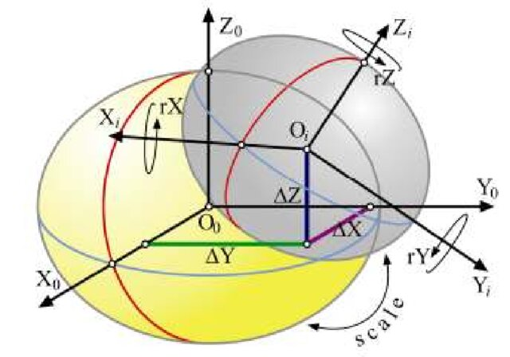
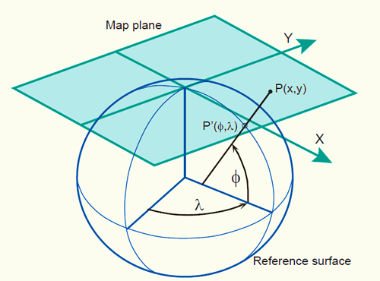
ISO 19111 for coordinate referencing
ISO 19111:2019 “Geographic information – Referencing by coordinates”, https://www.iso.org/standard/74039.html.
This standard includes conceptual schema (i.e., a structured framework or a technical drawing) to describe referencing by coordinates. It defines the elements necessary to determine coordinate reference systems (CRS)¹, including a datum² and a coordinate system and provides description of operations, such as transformation or conversion, between two different CRSs.
Coordinate operations
Transformation operates on CRS through translation ΔX, ΔY, ΔZ, rotation rX, rY, rZ, and a scale factor¹
Coordinate set
collection of single-point positions
Coordinate set
collection of single-point positions
referenced to
referenced to
“Source” CRS
known datum XX
known coordinate system XX
Conversion changes coordinates remaining the same datum (e.g., ellipsoid axes). Conversion example: mapping of ellipsoidal to Cartesian coordinates using a map projection
“Derived” CRS
Transformation: new (derived) datum, known coordinate system YY
Conversion: inherited datum XX, known coordinate system YY
Coordinate reference system (CRS) is a coordinate system that is related to an object (e.g., the Earth) by a datum or a reference frame. In other words, it is a framework for mapping Earth’s geographic locations and vice versa, for relating maps to real-world locations on the Earth's surface. It encompasses a coordinate system, datum or a reference frame, units, and coordinate operations. References: “Introduction to Coordinate Reference Systems“, https://www.earthdatascience.org/courses/earth-analytics/spatial-data-r/intro-to-coordinate-reference-systems/; ISO 19111:2019 “Geographic information – Referencing by coordinates”, https://www.iso.org/standard/74039.html.
Datum and reference frame is used interchangeably according to the modern ISO notations. For details see ISO 19111:2019 “Geographic information – Referencing by coordinates”, https://www.iso.org/standard/74039.html.
Other references used
The schematic is adopted from: National Geospatial-Intelligence Agency. "Department of Defense, World Geodetic System 1984, Its Definition and Relationships with Local Geodetic Systems." National Geospatial-Intelligence Agency, https://earth-info.nga.mil/php/download.php?file=coord-wgs84. Accessed 25 January 2025.
GIS Coordinate Reference Systems, https://www.youtube.com/watch?v=WWp1k0SlMUU, Accessed 31 January 2025.
Nedeljković Z. and Sekulić A.: Concept of spatial coordinate systems, their defining and implementation as a precondition in geospatial applications. Glasnik Srpskog geografskog drustva, 95(4), pp.77-102, https://doi.org/10.2298/GSGD1504077N, 2015.
ITC. "Map Projections." Geometric Aspects of Mapping, https://kartoweb.itc.nl/geometrics/Map%20projections/body.htm. Accessed January 26, 2025.

Slide 13
ISO 19161-1, 19161-2 for ITRS and ground stations identification
ISO 19161-1:2020 “Geographic information – Geodetic references – Part 1: International terrestrial reference system (ITRS)”, https://www.iso.org/standard/70655.html.
Sets standards on how to “realise” the ITRS according to different categories (e.g., general, primary, secondary) and intended purposes.
(under development, approved)
ISO 19161-2 “Geographic information – Geodetic references – Part 2: Unique identification of geodetic ground stations”, https://www.iso.org/standard/89134.html#lifecycle.
Modernises the method for unique identification of ground geodetic stations by replacing the existing Directory Of MERIT¹ Sites (DOMES) numbering system.
Contributes to interoperability among various Global Navigation Satellite Systems (GNSS).
Supports the United Nations Global Geospatial Information Management (UN-GGIM) actions on global geodetic reference frame.
DOMES number²: 10002M006
  The first 3 digits indicate the area, usually the country 100=France
  The next 2 digits indicate the site number within the country 02=Grasse
  The next letter indicates the tracking point "M" for monuments
  the last 3 digits represent a sequential point number 006 is GPS Pillar/brass mark
MERIT – an international program to Monitor Earth Rotation and Intercompare the Techniques (MERIT) of observation and analysis. For further details see
  Wilkins, G. A., and I. I. Mueller (1986), Rotation of the Earth and the Terrestrial Reference System, Eos Trans. AGU, 67(31), 601-605, doi:10.1029/EO067i031p00601.
  Wilkins, G.A., Mueller, I.I. (1986), On the rotation of the Earth and the terrestrial reference system. Bull. Géodésique 60, 85-100, https://doi.org/10.1007/BF02519356.
ITRF. "Description of the DOMES Numbering System." ITRF Network, https://itrf.ign.fr/en/network/domes/description. Accessed January 26, 2025.

Slide 14
Key definition: Metadata, identifier
From ISO/IEC¹ 11179-1:2023 “Information technology – Metadata registries (MDR) – Part 1: Framework”, https://www.iso.org/standard/78914.html
  Metadata are “data that define and describe other data.” In other words, metadata are descriptive data about an object (e.g., dataset, service, document, software).
From ISO 19135-1:2015 “Geographic information – Procedures for item registration”, https://www.iso.org/standard/54721.html
  Identifier is an independent sequence of characters capable of uniquely and permanently identifying the item with which it is associated.
File Identifier: example-id
Language: English
Character Set: UTF-8
Hierarchy Level: Dataset
Contact Information: Name Surname nsurname@example.com
Date Stamp: 2024-12-31
. . .
STRONGER.
TOGETHER.
IEC – International Electrotechnical Commission, https://www.iec.ch/homepage, https://www.electropedia.org/

Slide 15
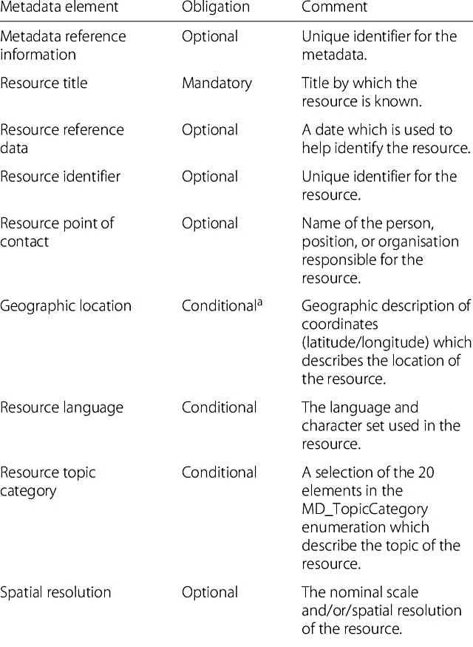
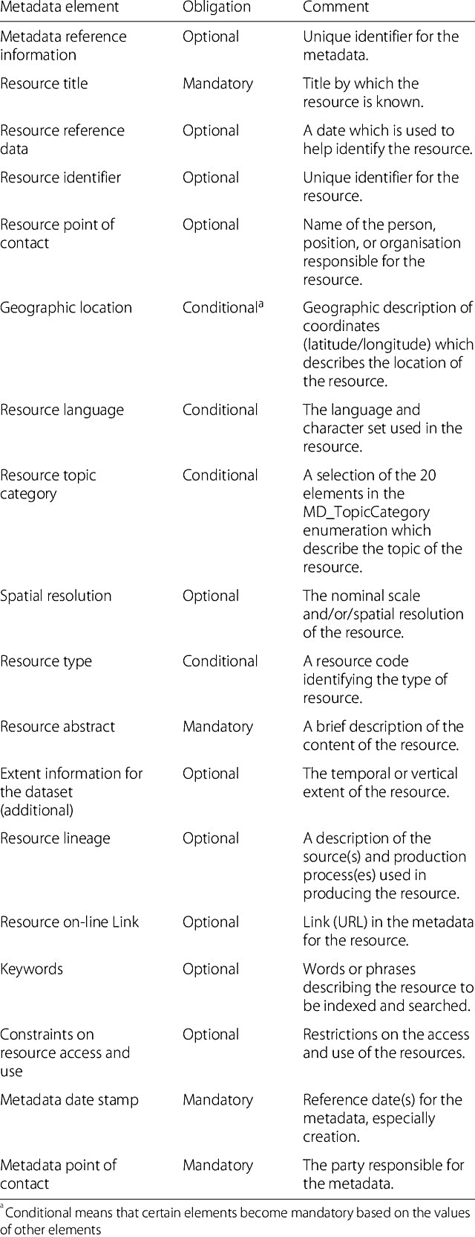
ISO 19115-1 standards for metadata in data cataloguing
ISO 19115-1:2014 “Geographic information – Metadata – Part 1: Fundamentals”, https://www.iso.org/standard/53798.html.
Identifies the metadata required to describe digital geographic information and services.
Introduces terminology and definitions, metadata classification (mandatory, conditional¹, optional).
Defines the minimum set of metadata attributes (e.g., extent, quality, temporal and spatial characteristics), required to serve most metadata applications (e.g., data access, data transfer).
“Conditional” may become “mandatory” based on the values of other elements.
Labetski, A., Kumar, K., Ledoux, H. et al. A metadata ADE for CityGML. Open geospatial data, softw. stand. 3, 16 (2018). https://doi.org/10.1186/s40965-018-0057-4.
As an example, Table F.1 “Metadata for the discovery of geographic datasets and series” from ISO 19115-1:2014 is shown².

Slide 16
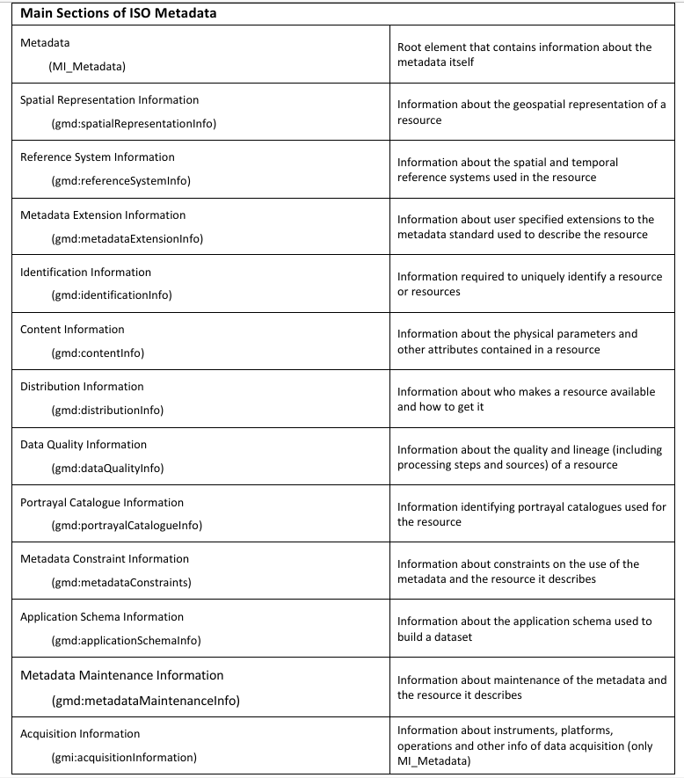
ISO 19115-2 standards for metadata during data processing
ISO 19115-2:2019 “Geographic information – Metadata – Part 2: Extensions for acquisition and processing”, https://www.iso.org/obp/ui/en/#iso:std:iso:19115:-2:ed-2:v1:en.
Extends ISO 19115-1 by introducing additional metadata required for acquisition and processing of digital geographic resources, e.g., for imagery.
Describes properties of numerical methods and computational procedures used to derive geographic information.
Provides standards for metadata acquisition and processing through XML encoding.
ISO 19115-2:2019 “Geographic Information — Metadata — Part 2: Extensions for Imagery and Gridded Data”, https://cdn.standards.iteh.ai/samples/67039/9eced1675a0748d392621dd2798091cb/ISO-19115-2-2019.pdf. Accessed January 26, 2025.
National Coastal Data Development Center, National Oceanographic Data Center, National Oceanic and Atmospheric Administration. "ISO 19115-2: Geographic information – Metadata Part 2: Extensions for imagery and gridded data. Guide to implementing ISO 19115-2:2009(E), the North American Profile (NAP), and ISO 19110 Feature Catalogue”, 2012.
Metadata packages of ISO 19115-1:2019¹ ²

Slide 17
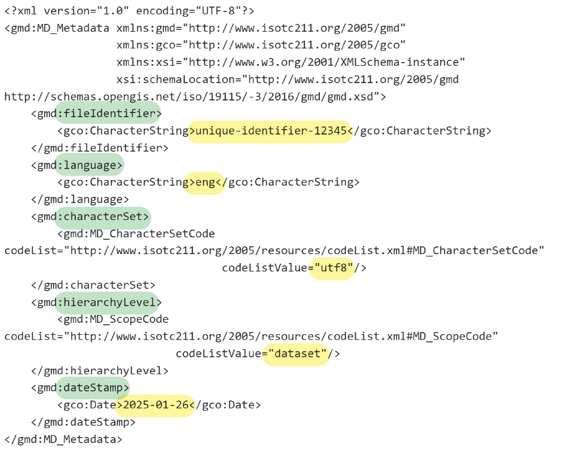
ISO 19115-3 standards for metadata XML encoding
ISO 19115-3:2023 “Geographic information – Metadata – Part 3: XML schema implementation for fundamental concepts”, https://www.iso.org/obp/ui/en/#iso:std:iso:19115:-3:ed-1:v1:en.
Describes the implementation of ISO 19115-1 and ISO 19115-2 in an integrated XML (for data storage and transfer) format.
Provides a standardised way to encode and exchange metadata for geographic information in a client-server environment, exemplified by the World Wide Web (www).

Slide 18
Key definitions: Register, registry, registration
From ISO 19135-1:2015 “Geographic information – Procedures for item registration”, https://www.iso.org/standard/54721.html
Register is a set of files containing identifiers assigned to items, along with descriptions of the attributes associated with those items
Registry is an “information system¹ on which a register is maintained”.
Registration is an assignment of a permanent, unique, and unambiguous identifier to an item.
STRONGER.
TOGETHER.
Information system is a system that manages communication (i.e., information exchange) along with information processing. Source: International Organization for Standardization. ”ISO 5127:2017(en) Information and Documentation – Foundation and Vocabulary”. 2nd ed., https://www.iso.org/obp/ui/en/#iso:std:iso:5127:ed-2:v1:en. Accessed 20 January 2025.

Slide 19
ISO 19135 for registering geographic information items
ISO 19135-1:2015 “Geographic information – Procedures for item registration”, https://www.iso.org/standard/54721.html
Describes procedures for establishing, maintaining, and publishing registers of geographic information.
Defines roles and responsibilities in the management of registers.
Provides register classification.
Specifies elements that are necessary to manage the registration of items assigned to geographic information.
ISO 19135-1:2015 “Geographic information – Procedures for item registration”, https://cdn.standards.iteh.ai/samples/54721/f508c246f1e84056a1b367e9855bd8ff/ISO-19135-1-2015.pdf. Accessed January 26, 2025.
Roles in the management of a register and relationships between them according to ISO 19135-1:2015¹

Slide 20
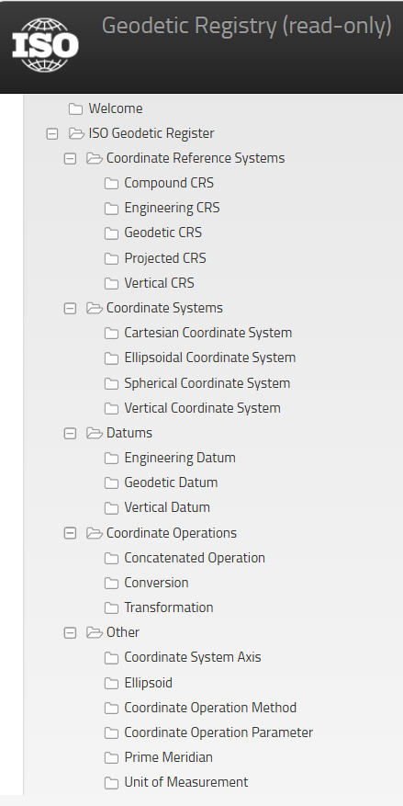
ISO 19127 for geodetic register
More details will be provided in
2.3.3 Geodetic registers
ISO 19127:2019 “Geographic information – Geodetic register”, https://www.iso.org/standard/67252.html
Specifying the data elements required within the geodetic register, in accordance with ISO 19111:2007 “Spatial referencing by coordinates” and ISO 19135-1:2015 “Procedures for item registration”.
Defines the management and operations of the ISO geodetic register, including roles, responsibilities, rules, and procedures.
Example of a geodetic registry: ISO Geodetic Registry (ISOGR), https://geodetic-v1.isotc211.org
Structured database of coordinate reference systems (CRS) and their transformations
Source: https://geodetic-v1.isotc211.org

Slide 21
Overview of ISO standardisation
Benefits
Globally recognised
Compliant with legal regulatory requirements
Enhances operational efficiency
Reduces risks and operational cost
Improves geodetic product and service quality
Enhances system compatibility with other sectors
Improves data discoverability
Enhances system sustainability
Deficits
High implementation and maintenance cost
Time-consuming implementation process
Heavy bureaucracy
Requires special expertise
Requires continuous commitment to sustain the standards
STRONGER.
TOGETHER.

Slide 22
OUTLINE
Introduction and key definitions
ISO standards
OGC standards
Other standardisation practices
Summary and conclusions
3.1 What is OGC?
3.2 Types of OGC standards
3.3 OGC and ISO standards compatibility

Slide 23
What is OGC?
Open Geospatial Consortium (OGC) is a non-profit international voluntary open-membership consensus standards organisation founded in 1994
OGC mission is to develop open free of charge standards that “enable interoperability¹ and seamless integration of geospatial information, geoprocessing software, and geospatial services”²
OGC standards are internationally recognized technical documents, developed by OGC, that describe specifications and protocols to ensure optimal interoperability of different geospatial systems²
OGC has
  500+ members including vendors, government agencies, universities and research institutions (as of 2017)³
  50+ standards⁴ ⁵
OGC closely cooperates with ISO and other standards developing organisations
Interoperability is the ability of two or more components or services to exchange and mutually utilize information without affecting their functionality or performance. Interoperability implies the integration and compatibility of those components or services (e.g., geodetic devices, data formats, standards). Source: International Organization for Standardization. "ISO/IEC TR 15944-14:2020 Information technology — Business operational view — Part 14: Open-edi reference model and cloud computing architecture." 1st ed., https://www.iso.org/standard/73177.html. Accessed 4 February 2025.
Open Geospatial Consortium. "OGC - Open Geospatial Consortium.", https://www.ogc.org/. Accessed 9 January 2025.
Bermudez, L. “New frontiers on open standards for geo-spatial science.”, Geo-Spatial Information Science, 20(2), 126-133. https://doi.org/10.1080/10095020.2017.1325613, 2017.
Simmons, S. “OGC and the Relevance of Standards for Environmental Matters.” Open Geospatial Consortium. https://www.landcareresearch.co.nz/assets/Events/Link-series/OGC_relevance_standards_environmental_matters.pdf, 2017.
Open Geospatial Consortium. “Progress of Official OGC Standards”, https://portal.ogc.org/public_ogc/standards/standards_workflow.php?bg=1. Accessed February 7, 2025.

Slide 24
Functional areas of OGC standards¹ ²
Data exchange with users
Containers
Standards to store and retrieve geospatial data and geospatial information (e.g., imagery, raster maps, tabular data)
E.g., GeoPackage, OGC netCDF standards suite
Discovery
Standards to search for geospatial data, services, and related information objects
E.g., Catalogue Service, Ordering Services Framework for Earth Observation Products, OpenSearch
Publish-Subscribe, Syndication & Context
Standards to ensure efficient distribution of geospatial data, defining how providers can publish updates and how subscribers receive notifications
E.g., Publish/Subscribe, GeoRSS
OGC APIs³ ⁴
Standards to simplify access, usage and sharing of geospatial data and services via modern web development practices
E.g., OGC API – Maps, OGC API – Processes, OGC API - Environmental Data Retrieval
Services
Standards to access, share, and process geospatial data over the web, based on older web development practices (e.g., HyperText Transfer Protocol (HTTP)
E.g., Web Coverage Service, Web Map Service (WMS), Web Processing Service (WPS), Coordinate Transformation Service
Web features (interface)
Data Models and Encodings – General
Standards to organise information sent by a service provider or produced by software
Convert geospatial content into an encoding format shareable across different systems
E.g., Geography Markup Language (GML), Geodetic data Grid eXchange Format (GGXF), EO Dataset Metadata GeoJSON(-LD).
Data Models and Encodings – Domain Specific
Standards to organise information by defining geospatial data structures and their relationships
Facilitate information exchange within a specific domain across different systems
E.g., CityGML, OGC WaterML, OGC LandInfra / InfraGML
Data (encoding)
Sensor web⁵
Sensors
Standards to access sensors that are connected to the Web or the Internet of Things (e.g., environmental monitoring devices)
E.g., Sensor Model Language (SensorML), Sensor Observations Service (SOS), Sensor Model Language (SensorML)
OGC basis
Abstract
Specification⁶
Foundation and semantics to develop OGC standards, e.g., open interfaces and protocols are built and referenced against the Abstract Specification
Specific set of abstract models grouped into several topic volumes (e.g., Space and Time, Metadata and Quality, Services and Interfaces)
Open Geospatial Consortium. “Publications”, https://www.ogc.org/publications/. Accessed February 7, 2025.
Huang, M., Fan, X., Jian, H., Zhang, H., Guo, L., and Di, L.: Bibliometric Analysis of OGC Specifications between 1994 and 2020 Based on Web of Science (WoS), ISPRS Int. J. Geo-Inf., 11, 251, https://doi.org/10.3390/ijgi11040251, 2022.
Application programming interface (API) – a set of methods, functions, protocols, routines, or commands that application software uses, along with programming language facilities, to invoke services (e.g., web-based systems). In other words, an API is a set of rules and specifications that software programs can follow to communicate with each other, enabling the integration of various services and functionalities. Source: ISO/TS 23029:2020 “Web-service-based application programming interface (WAPI) in financial services”, https://www.iso.org/obp/ui/#iso:std:iso:ts:23029:ed-1:v1:en. Accessed February 5, 2025.
Open Geospatial Consortium. “OGC API Standard”, https://ogcapi.ogc.org/. Accessed February 5, 2025.
A sensor network is a computer accessible network of multiple spatially distributed devices using sensors to monitor conditions at different locations (e.g., temperature, vibration, pressure). A sensor web refers to World Wide Web (web) accessible sensor networks and archived sensor data that can be discovered and accessed via standard protocols and APIs. Source: Open Geospatial Consortium. "OGC Sensor Web Enablement: Overview And High Level Architecture. SWE White Paper", http://www.opengis.net/doc/wp/swe-high-level-architecture, 2013.
Open Geospatial Consortium. "OGC Abstract Specification Topic 0 - Overview", http://www.opengis.net/doc/AS/topic-0/9.0, 2020.

Slide 25
Other types of OGC documents
Best Practices
Describe the use of OGC standards to address domain-specific topics or solve interoperability challenge; they also may describe implemented extensions to OGC standards. These documents are an official OGC position, i.e., endorsed by the OGC Members
Community Practices
Describe standards, specifications, or technologies that address interoperability requirements in geospatial and related communities, but were developed outside of OGC
Discussion Papers
Present topics or technology issues being considered in the Working Groups of the OGC Technical Committee, promoting new interoperability concepts within the geospatial industry. These papers do not represent the official position of the Open Geospatial Consortium
Technical Papers
Address technology issues relevant to OGC Members and the broader geospatial community. They provide essential background to highlight and predict trends and are intended to guide future developments
Guidance documents
Provide informative guidance on the development of OGC documents and products
The slide is developed based on the following literature:
Open Geospatial Consortium. “Other Publications”, https://www.ogc.org/other-publications/. Accessed February 7, 2025.
Reed, C. “OGC Standards: Enabling the Geospatial Web”. In Advances in Web-Based GIS, Mapping Services and Applications, edited by L. Songnian, S. Dragicevic, and B.Veenendaal, 327-348. London: CRC Press, 2011.

Slide 26
OGC and ISO compatibility
STANDARDS TYPE | OGC STANDARD | ISO STANDARD
Coordinate referencing standards Standards for describing and representing geographical locations in coordinate systems | OGC Abstract Specification Topic 2: Referencing by coordinates, http://www.opengis.net/doc/AS/topic-2/5.0 | ISO 19111:2019 Geographic information – Referencing by coordinates, https://www.iso.org/obp/ui/en/#iso:std:iso:19111:ed-3:v1:en
 | Geographic information – Well-known text representation of coordinate reference systems, http://www.opengis.net/doc/is/crs-wkt/2.1.11 | ISO 19162:2019 Geographic information – Well-known text representation of coordinate reference systems, https://www.iso.org/obp/ui/en/#iso:std:iso:19162:ed-2:v1:en
Data structure standards Standards to represent and manage coverage data consistently across different applications | OGC Abstract Specification Topic 6: Schema for Coverage Geometry and Functions – Part 1: Fundamentals, http://www.opengis.net/doc/AS/Topic-6.1/2.0 | ISO 19123-1:2023 Geographic information – Schema for coverage geometry and functions – Part 1: Fundamentals, https://www.iso.org/obp/ui/en/#iso:std:iso:19123:-1:ed-1:v1:en
 | OGC Coverage Implementation Schema, http://www.opengis.net/doc/IS/cis/1.1 | ISO 19123-2:2018 Geographic information – Schema for coverage geometry and functions – Part 2: Coverage implementation schema, https://www.iso.org/obp/ui/en/#iso:std:iso:19123:-2:ed-1:v1:en

Slide 27
OGC and ISO compatibility
STANDARDS TYPE | OGC STANDARD | ISO STANDARD
Data encoding standard Standards for the XML Schema syntax, mechanisms, and conventions to transport and store geographic information | Geography Markup Language (GML), https://www.ogc.org/publications/standard/gml/ | ISO 19136-1:2020Geographic information – Geography Markup Language (GML) – Part 1: Fundamentals, https://www.iso.org/obp/ui/en/#iso:std:iso:19136:-1:ed-1:v1:en
Service and interface standards Standards for interacting with different services to discover, access, or process geographic information | OGC API – Features, https://www.ogc.org/publications/standard/ogcapi-features/ | ISO 19168-1:2025 Geographic information – Geospatial API for features – Part 1: Core, https://www.iso.org/obp/ui/en/#iso:std:iso:19168:-1:ed-2:v1:en
 | OGC Web Map Service (WMS), https://www.ogc.org/publications/standard/wms/ | ISO 19128:2005 Geographic information – Web map server interface, https://www.iso.org/obp/ui/en/#iso:std:iso:19128:ed-1:v1:en
 | OGC Web Feature Service (WFS), https://www.ogc.org/de/publications/standard/wfs/ | ISO 19142:2010 Geographic information – Web Feature Service, https://www.iso.org/obp/ui/en/#iso:std:iso:19142:ed-1:v1:en

Slide 28
OUTLINE
Introduction and key definitions
ISO standards
OGC standards
Other standardisation practices
Summary and conclusions
4.1 Geodetic Formats
4.2 INSPIRE
4.3 SI and physical constants
4.4 FAIR principles for data management
4.5 Resolutions and conventions

Slide 29
Selection of GNSS Data and Metadata Formats
Format/Standard Information
SSR v1.0 The IGS State Space Representation (SSR) format is an open standard for dissemination of real-time products to support the IGS Real-Time Service and the wider community. The messages support multi-GNSS and include corrections for orbits, clocks, DCBs, phase-biases and ionospheric delays.
RINEX v. 4.02 RINEX 4.02 (2024) is an upgrade of the format document that introduces the pico-second resolution to the observations time tagging, as well as new navigation messages for NavIC L1 and GLONASS L1 and L3 CDMA. In addition, navigation messages subtypes have been introduced, to support dual ION models available for the QZSS and NavIC systems. Additional editorial changes have been introduced to improve clarity.
SINEX station position and velocity solutions
sp3 version d GNSS and SBAS orbit solutions
sp3 version c GPS and GLONASS orbit solutions
erp Earth rotation parameter files
clock RINEX 3.04 station and satellite clock solutions
Bias-SINEX V1.00 GNSS code and phase biases for satellites and stations
IONEX V1.00 ionospheric TEC grid products
Tropo SINEX v2.00 Solution (Software/Technique) Independent Exchange (SINEX) format for TROpospheric and meteorological parameters
Tropo SINEX Zenith path delay products
site log v2.0 History of site installation
ANTEX Format ANTEX: The Antenna Exchange Format, Version 1.4
STRONGER.
TOGETHER.
https://igs.org/formats-and-standards

Slide 30
INSPIRE
The European INSPIRE (Infrastructure for Spatial Information in Europe) program is an initiative aimed at creating a unified spatial data infrastructure across Europe. This program is designed to facilitate the sharing of environmental spatial information among public sector organizations and improve public access to spatial information across Europe. The INSPIRE Directive, which was established in 2007, sets the legal framework for this initiative.
The main objectives of the INSPIRE program include:
  Interoperability: Ensuring that spatial data from different sources across Europe can be combined and used seamlessly.
  Accessibility: Making spatial data more accessible to the public and various stakeholders.
  Harmonization: Standardizing spatial data to ensure consistency and compatibility across different regions and sectors.
  Support for Environmental Policies: Providing reliable spatial data to support environmental policies and decision-making processes.
  The INSPIRE program covers a wide range of spatial data themes, including land use, transportation networks, hydrography, and protected sites, among others. It aims to create a more efficient and effective way of managing and using spatial data to address environmental and societal challenges.
STRONGER.
TOGETHER.

Slide 31
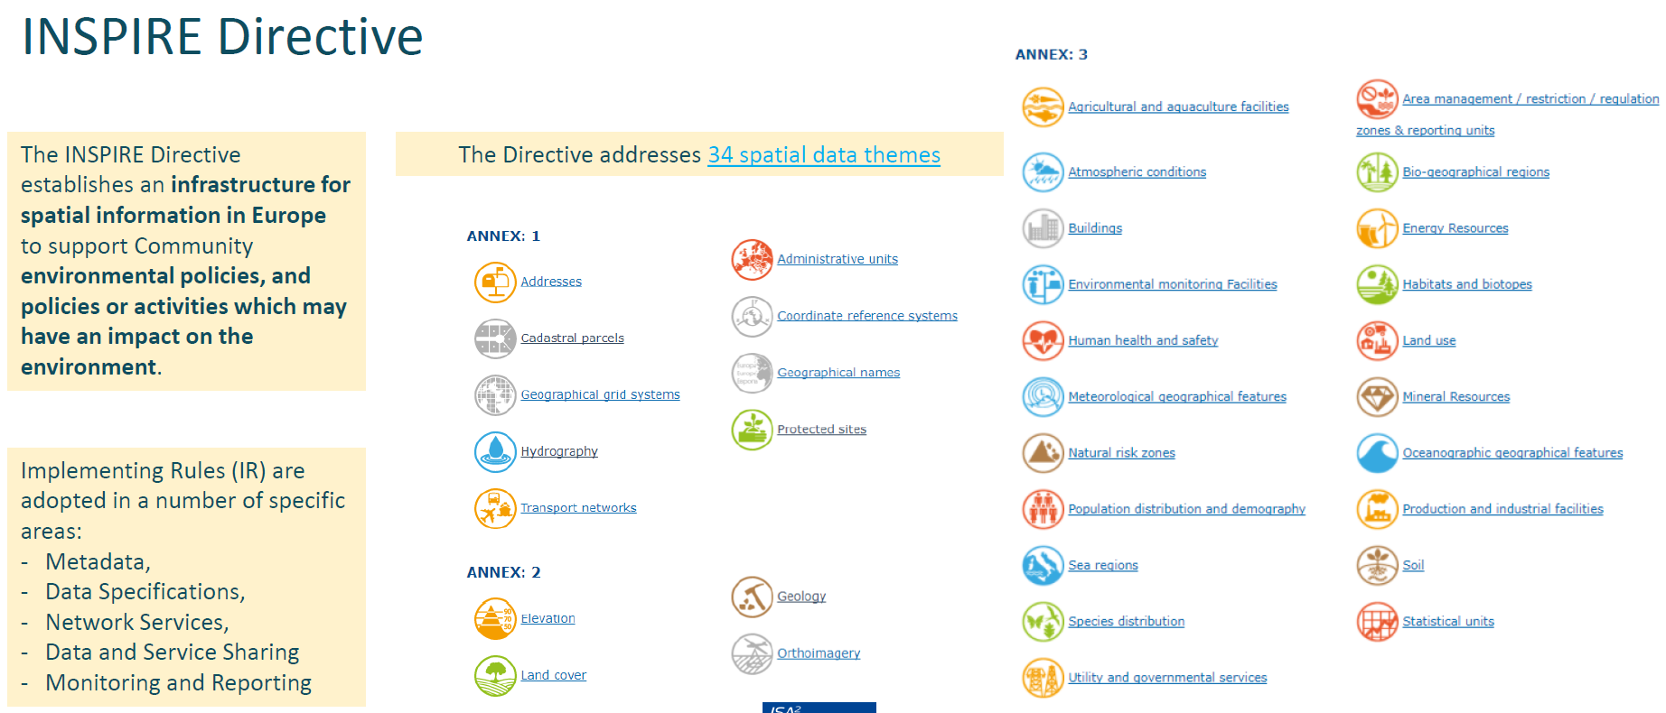
Content of the INSPIRE directive

Slide 32
SI and physical constants
  Geodesy-relevant base quantities and units
International system of Units (SI) – internationally accepted system of physical units, https://www.bipm.org/en/measurement-units
SI is maintained by the Bureau International des Poids et Mesures (BIPM; in English – The International Bureau of Weights and Measures), https://www.bipm.org
Base quantity name | Base unit name | Base unit symbol
time | second | s
length | metre | m
mass | kilogram | kg
Fundamental physical constants (PC) – physical quantities that are assumed to be universal in nature and constant in time; regularly reviewed by CODATA for accuracy and reliability¹ ²
PC are developed and maintained by the Task Group of the Committee on Data for Science and Technology (CODATA) under the International Science Council (ISC), https://codata.org/initiatives/data-science-and-stewardship/fundamental-physical-constants/, https://council.science/
PC values and accuracy are derived from the technical and experimental research conducted by the National Institute of Standards and Technology (NIST) of the USA, https://www.nist.gov/pml/fundamental-physical-constants, https://physics.nist.gov/cuu/Constants/index.html
  Geodesy-relevant fundmental physical constants
Name | Symbol | Value | Unit symbol
Newtonian constant of gravitation | G | 6.674 30(15) x 10⁻¹¹ | m³ kg⁻¹ s⁻²
Speed of light in vacuum | c | 299 792 458 | m s⁻¹
Standard acceleration of gravity | g_{n} | 9.806 65 | m s⁻²
Standard atmosphere | atm | 101 325 | Pa
Angermann, D., Gruber, T., Hugentobler, U., Sánchez, L., Gerstl, M., Heinkelmann, R., & Steigenberger, P. (2020). Inventory of Standards and Conventions used for the Generation of IAG Products. International Association of Geodesy. Retrieved from https://iag-aig.org/doc/GH2020/402_Inventory.pdf.
National Institute of Standards and Technology (NIST). “Fundamental Physical Constants. Introduction to the constants for nonexperts”, https://physics.nist.gov/cuu/Constants/introduction.html. Accessed February 12, 2025.

Slide 33

FAIR¹ ² principles for data management
  Concise and measurable set of principles to increase reusability of digital assets
Findability
  (Meta)data are assigned a globally unique and persistent identifier
  Data are described with rich metadata (see “Reusable”)
  Metadata clearly and explicitly include the identifier of the data they describe
  (Meta)data are registered or indexed in a searchable resource
Accessibility
  (Meta)data are retrievable by their identifier using a standardised communications protocol
  The protocol is open, free, and universally implementable
  The protocol allows for an authentication and authorisation procedure, where necessary
  Metadata are accessible, even when the data are no longer available
Interoperability
  (Meta)data use a formal, accessible, shared, and broadly applicable language for knowledge representation.
  (Meta)data use vocabularies that follow FAIR principles
  (Meta)data include qualified references to other (meta)data
Reuse
  (Meta)data are richly described with a plurality of accurate and relevant attributes
  (Meta)data are released with a clear and accessible data usage license
  (Meta)data are associated with detailed provenance
  (Meta)data meet domain-relevant community standards
GO FAIR. “FAIR Principles”, https://www.go-fair.org/fair-principles. Accessed February 13, 2025.
Wilkinson, M., Dumontier, M., Aalbersberg, I. J., et al. (2016). The FAIR guiding principles for scientific data and stewardship. Scientific Data, 3, 160018. https://doi.org/10.1038/sdata.2016.18.

Slide 34
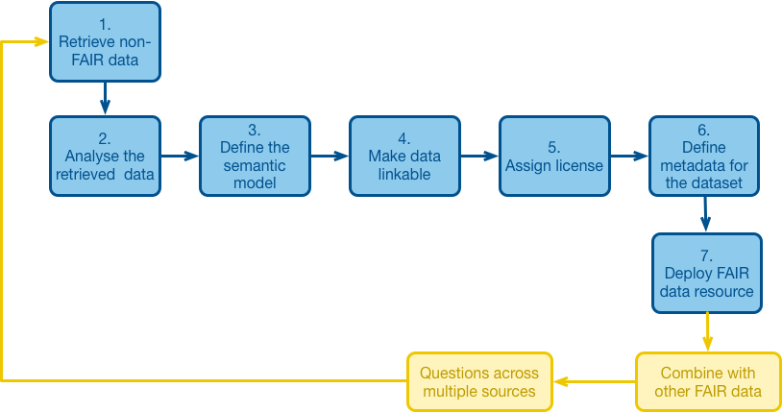
FAIRification process
FAIR principles
  emphasise machine-actionability, i.e., capacity of computational systems to find, access, interoperate, and reuse data with minimal or no human intervention¹
  applicable to data, metadata, and the supporting infrastructure (e.g., search engines)²
Guidelines on FAIRification on national level, https://www.go-fair.org/resources/go-fair-materials/materials-for-countries
Collection of references to “FAIR Data Resources”, https://www.zotero.org/groups/2345721/fair_data_resources
GO FAIR. “FAIR Principles”, https://www.go-fair.org/fair-principles. Accessed February 13, 2025.
GO FAIR. “FAIRification Process”, https://www.go-fair.org/fair-principles/fairification-process. Accessed February 13, 2025.

Slide 35
Resolutions and conventions
Resolution is a written document (e.g., decision, expression of opinion) for the adoption of standards, constants, or parameters to be used by institutions affiliated with the adopting body¹
Convention is a set of agreed-upon and accepted practices or methods that is widely followed within a particular field of study¹
Main bodies for adopting resolutions and conventions on geodesy
  International Association of Geodesy (IAG), https://office.iag-aig.org/iag-and-iugg-resolutions
  International Astronomical Union (IAU), https://www.iau.org/administration/resolutions/general_assemblies
  International Union of Geodesy and Geophysics (IUGG), https://iugg.org/publications/resolutions
  International Earth Rotation and Reference Systems Service (IERS), https://www.iers.org/IERS/EN/DataProducts/Conventions/conventions.html
Examples
  (2010) IERS Conventions Package (11 Chapters)
  (2015) IUGG Resolution No. 3 on the Global Geodetic Reference Frame (GGRF) recognising the adoption of a resolution entitled “A Global Geodetic Reference Frame for Sustainable Development”² in February 2015 by the General Assembly of the United Nations
  (2018) IAU Resolution B2 on the Third Realisation of the International Celestial Reference Frame
  (2019) IAG Resolution No. 1 on the International Terrestrial Reference Frame (ITRF)
  (2023) IUGG Resolution No. 1 on Improving Protection of Geodetic Observatories from Active Radio Services
  (2023) IUGG Resolution No. 3 on Sharing Geophysical Data across Borders
Angermann, D., Gruber, T., Hugentobler, U., Sánchez, L., Gerstl, M., Heinkelmann, R., & Steigenberger, P. (2020). Inventory of Standards and Conventions used for the Generation of IAG Products. International Association of Geodesy. Retrieved from https://iag-aig.org/doc/GH2020/402_Inventory.pdf.
UN Resolution 69/266. (2015). Resolution adopted by the General Assembly on 26 February 2015. A global geodetic reference frame for sustainable development. Retrieved May 31, 2024, from https://ggim.un.org/documents/A_RES_69_266_E.pdf

Slide 36
Summary
Explored standardisation practices throughout the data lifecycle in geodesy
ISO standards (ISO 6709, ISO 19111, ISO 19115, ISO 19161, ISO 19127, ISO 19135)
Types of OGC standards
ISO and OGC compatibility
International System of Unites (SI) and fundamental physical constants
Resolutions and conventions
FAIR principles for data management
Learnt definitions
Standard
Standardisation
Metadata
Identifier
Register
Registry
Registration
STRONGER.
TOGETHER.

Slide 37
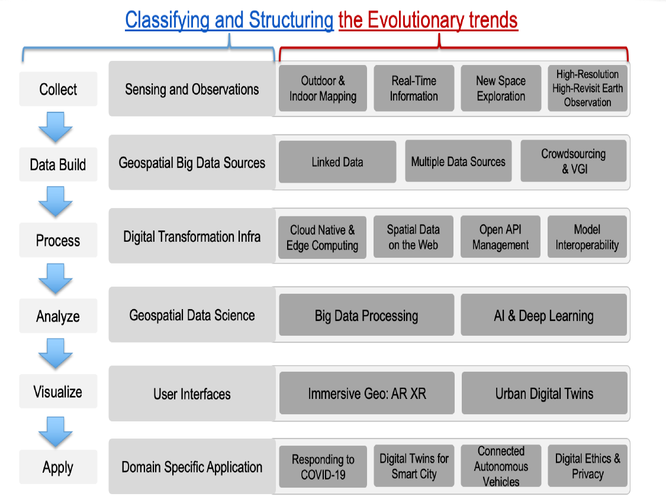
Outlook: Trends in geospatial data standards development
Source: United Nations Committee of Experts on Global Geospatial Information Management. (2022). A Guide to the Role of Standards in Geospatial Information Management, Ed. 3.0.0:2022-01-01, 80 pp. Retrieved from https://standards.unggim.ogc.org/unggim_guide.pdf.
Abbreviations: VGI – volunteered geographic information. VGI is a concept describing the collection of geospatial data by citizens (i.e., non-domain experts), acting as sensors to gather information about the world around them.

Slide 38
Take-home message
(non-technical) Benefits of implementing data standardisation
Access to expert communities for knowledge exchange
Establishing international partnerships with government and academia
Participation in potential funding programs
Understanding emerging technology trends and fostering an innovative workforce culture to develop new tools, methods, or services
Improving data production and data management efficiency (i.e., cost and time saving)
Avoiding duplicated efforts (i.e., cost and time saving through data reuse)
Contributing to the UN-GGCE efforts towards robust Global Geodesy Supply Chain
Contributing to the UN Sustainable Development Goals
The slide is developed based on the following literature:
United Nations Committee of Experts on Global Geospatial Information Management. (2022). A Guide to the Role of Standards in Geospatial Information Management, Ed. 3.0.0:2022-01-01, 80 pp. Retrieved from https://standards.unggim.ogc.org/unggim_guide.pdf.

Slide 39
Q & A

Slide 40


Proposed hands-on activity: Exploring standards
(5 mins) Work in pairs with the colleague seated next to you
  Discuss what new you have learnt during the course and how you can apply it in your work.
(15 mins) Work in pairs with the colleague seated to you
  Visit the following websites to explore data standards:
  ISO standards, https://www.iso.org
    Use "Search" function to find the desired standards (e.g., ISO 19111)
    Read a sample of the standard and examine its structure.
  OGC standards, OGC standards, https://www.ogc.org
    Find the desired standard under "Publications“, e.g., “Abstract Specifications” -> “Topic 2 – Referencing by coordinates (Including corrigendum 1 and corrigendum 2)”. Use "Search" function if needed
    Read a sample of the standard and examine its structure, compare it with the respective ISO standard
ISO
OGC

Slide 41

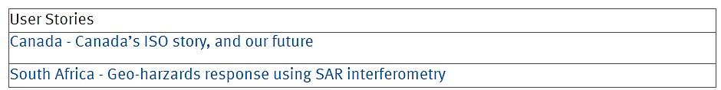
Proposed hands-on activity: Exploring standards
(10 mins) Work independently
  Visit the ISO/TC 211 website to explore the standards:
  https://committee.iso.org/home/tc211
  Navigate to “Projects” -> “Projects - Complete list”
  Learn more from experiences of Member States; choose at least one example. For example, there are two stories from ISO 19115-2
(15 mins, approx. 5 mins per person) Work in groups of three
  Share your insights, discuss
  What can you adopt from the Member States stories for your organisation / country?
ISO/TC 211

Slide 43
Additional resources: ISO
ArcGIS Pro: Create ISO 19115-1 and ISO 19115-3 metadata, https://pro.arcgis.com/en/pro-app/latest/help/metadata/create-iso-19115-1-and-iso-19115-3-metadata.htm.
ISO TC 211: ISO Geodetic Registry (ISOGR), https://geodetic-v1.isotc211.org/.
ISO TC 211: Good practice, https://committee.iso.org/sites/tc211/home/resolutions/isotc-211-good-practices.html.
ISO TC 211: ISO/TC 211 Multi-Lingual Glossary of Terms (MLGT), https://isotc211.geolexica.org/.
ISO TC 211: ISO/TC 211 Resources, https://www.isotc211.org/.
ISO TC 211: XML schema representations of geographic technology standards, https://schemas.isotc211.org.
ISO/TC 211: Support for United Nations activities, https://committee.iso.org/sites/tc211/home/standards-in-action/united-nations.html.
ISO/TC 211/WG 9: Geographic information – Geodetic register user guide, https://iso-tc211.github.io/iso-geodetic-register-docs/documents/user-guide.html
ISO/TC 211: GitHub Repository, https://github.com/ISO-TC211.
NOAA National Coastal Data Development Center. (2012). ISO 19115 Geographic information – Metadata Workbook: Guide to Implementing ISO 19115:2003(E), the North American Profile (NAP), and ISO 19110 Feature Catalogue. Silver Spring, MD, NOAA National Coastal Data Development Center, 248pp. http://dx.doi.org/10.25607/OBP-770.

Slide 44
Additional resources: OGC
Duque, J. P., Pugliese, A. D. J., and Brovelli, M. A. (2024). A standardised approach for serving environmental monitoring data compliant with OGC APIs, Int. Arch. Photogramm. Remote Sens. Spatial Inf. Sci., XLVIII-4/W12-2024, 51–58, https://doi.org/10.5194/isprs-archives-XLVIII-4-W12-2024-51-2024.
Huang, M., Fan, X., Jian, H., Zhang, H., Guo, L., & Di, L. (2022). Bibliometric Analysis of OGC Specifications between 1994 and 2020 Based on Web of Science (WoS). ISPRS International Journal of Geo-Information, 11(4), 251. https://doi.org/10.3390/ijgi11040251.
Open Geospatial Consortium (2021). OGC Testbed-17: UML Modeling Best Practice Engineering Report, https://docs.ogc.org/per/21-031.pdf.
Open Geospatial Consortium. GitHub, https://github.com/opengeospatial.
Open Geospatial Consortium: Glossary of Terms, https://defs.opengis.net/vocprez/object?uri=http%3A//www.opengis.net/def/glossary.
Open Geospatial Consortium: List of Best Practices, https://www.ogc.org/best-practice/.
Open Geospatial Consortium: List of Community Practices, https://www.ogc.org/community-practices/.
Open Geospatial Consortium: List of Discussion Papers, https://www.ogc.org/discussion-papers/.
Open Geospatial Consortium: List of Technical Papers, https://www.ogc.org/technical-papers/.
Open Geospatial Consortium: OGC Schema Repository, https://schemas.opengis.net/.
Open Geospatial Consortium: OGC’s Registry for Accessible Identifiers of Names and Basic Ontologies for the Web (OGC Rainbow), https://defs.opengis.net/vocprez/.
Open Geospatial Consortium: Standards, https://www.ogc.org/publications/.
Sofos, I., Vescoukis, V., Gkegkas, A., and Tsilimantou, E. (2017). Applying OGC Standards to Develop a Land Surveying Measurement Model. ISPRS International Journal of Geo-Information, 6(3), 67, https://doi.org/10.3390/ijgi6030067.

Slide 45
Additional resources
Angermann, D., Gruber, T., Gerstl, M., Heinkelmann, R., Hugentobler, U., Sánchez, L., & Steigenberger, P. (2020). Inventory of standards and conventions used for the generation of IAG products. International Association of Geodesy. Retrieved from https://iag-aig.org/doc/GH2020/402_Inventory.pdf
Bermudez, L. (2017). New frontiers on open standards for geo-spatial science. Geo-Spatial Information Science, 20 (2), 126–133. https://doi.org/10.1080/10095020.2017.1325613.
GGOS Bureau of Products and Standards, https://www.dgfi.tum.de/en/international-services/ggos-bureau-of-products-and-standards/
Guide to Coordinate Reference System (CRS) Resources. (2022). Joint ISO/TC 211, OGC, IOGP text. Retrieved from https://committee.iso.org/files/live/sites/tc211/files/Resources/GuideToCRSRegistries3.pdf.
INSPIRE Knowledge Base: Infrastructure for Spatial Information in Europe, https://knowledge-base.inspire.ec.europa.eu.
Ivanova, I., Brown, N., Rubinov, E., Fraser, R., and Tengku N. (2020). Ensuring fair access to precise positioning by improving geodetic data interchange standards. Retrieved from https://frontiersi.com.au/wp-content/uploads/2020/11/P1003-Geodetic-Standards-Final-Report.pdf.
United Nations Committee of Experts on Global Geospatial Information Management. (2022). A Guide to the Role of Standards in Geospatial Information Management, Ed. 3.0.0:2022-01-01, 80 pp. Retrieved from https://standards.unggim.ogc.org/index.php
United Nations Committee of Experts on Global Geospatial Information Management. A Guide to the Role of Standards in Geospatial Information Management, Appendix 1:Standards Inventory, https://standards.unggim.ogc.org/Appendix1.html
United Nations Committee of Experts on Global Geospatial Information Management. A Guide to the Role of Standards in Geospatial Information Management, Appendix 7: Communities of Practice, https://standards.unggim.ogc.org/Appendix7.html.
United Nations Committee of Experts on Global Geospatial Information Management. A Guide to the Role of Standards in Geospatial Information Management, Appendix 8: References, Resources, and Tools, https://standards.unggim.ogc.org/Appendix8.html.
World Standards Cooperation: Standardization Programme Coordination Group (SPCG), https://www.worldstandardscooperation.org/

